Slide 1


Improving how Emergency Room in Haiti handle patient’s information
BY: Luc Celestin & Ruth Vincent

Slide 2

History of Haiti
Haiti, country in the Caribbean Sea that includes the western third of the island of Hispaniola and is the poorest country in the Western Hemisphere
Haiti, whose population is almost entirely descended from African slaves, won independence from France in 1804, making it the second country in the Americas, after the United States, to free itself from colonial rule.
Over the centuries, however, economic, political, and social difficulties, as well as several natural disasters, have beset Haiti with chronic poverty and other serious problems.

Slide 3
Hardships for Haiti
Extreme inequality, poverty and crime
Food, water, farming, and hunger
Natural disasters
2010 7.0 Earthquake
2016 Hurricane Matthew (category 4)
Political instability
Depreciation of the gourde

Slide 4
Cyber Security & Haiti
Specific legislation and regulation related to cybersecurity has been enacted through the following instruments:
None.
Haiti does not have an officially recognized national or sector-specific cybersecurity strategy.
The central Directorate of the Judicial Police (Direction Centrale de la Police Judiciaire –DCPJ) takes the lead on investigating identified cyber attacks
Haiti does not have any officially approved national or sector specific cybersecurity framework for implementing internationally recognized cybersecurity standards.
There is no officially recognized national or sector-specific program for sharing cybersecurity assets within the public and private sector in Haiti. There is some degree of informal and unofficial cooperation between the public and private sector

Slide 5
Benefits of INFOSEC in Healthcare
Implementing a smart security strategy can actually boost productivity while protecting devices and data.
Criminals can use leaked information to sell on the black market which, in turn, can be used for identity theft, Medicare fraud, and for other financial gains. Also, preventing cyber attacks helps keep patient information confidential, which is important for legal reasons
Leaked Patient Information Can Be Costly
Population Is Growing Fast So Efficient Care Is Key

Slide 6

63% of companies said their data was potentially compromised within the last twelve months due to a hardware- or silicon-level security breach. (Source: CSOOnline)
Criminals can use leaked information to sell on the black market which, in turn, can be used for identity theft, Medicare fraud, and for other financial gains. Also, preventing cyber attacks helps keep patient information confidential, which is important for legal reasons.
Preventing cyber attacks in this instance is especially important because without being able to use technical data stored within databases and networks, it means healthcare professionals can’t be as efficient. It’s especially important today when the population is growing so fast that even an efficient industry can’t keep up with it.

Slide 7

Benefits of AI in healthcare
improve medical diagnosis
advancements in healthcare treatments
ability to design treatment plans

Slide 8


Project Requirements
Electricity/Power
Routers
Servers
Wireless Technology
Printers
Desktops/Monitors
Tablets
Security Cameras equipped with AI

Slide 9
Security
No access to the internet.
Security camera with facial recognition.
Video stream from security camera goes through the security office.
Biometric sensors to prevent untheorized access to certain areas.

Slide 10
MYSQL Server: holds information about a patient and the staff
Allow medical professional to have access to patient’s information stored in the database
Database & Application

Slide 11
Why Have a Database?
Centralize patient information
Tracking and planning of one’s treatment process, doctor’s appointments, vaccination dates and more
Reduction in medical facility running costs due to less paperwork and clerical staff
Provision of accurate, up-to-date patient information
Increase in efficiency due to quick access to records
Help with diagnosis and prescription. It will help in reducing medical errors
Assists with documentation and billing

Slide 12
Tables
personnelle_medicale - Hold the staff information
contact – Hold contact information about the Staff ( Email, cel, etc …)
patient – Hold Patient’s record
allergie - Hold information related to patient allergies.
admission - hold when the patient was admitted to the ER.
admission_entry –Hold any information related to patient’s condition

Slide 13
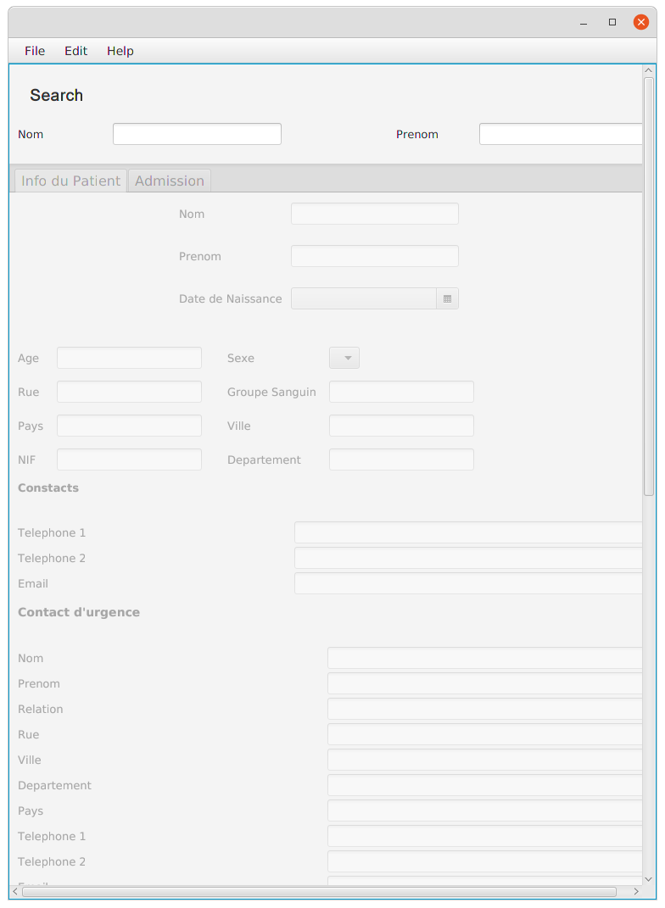
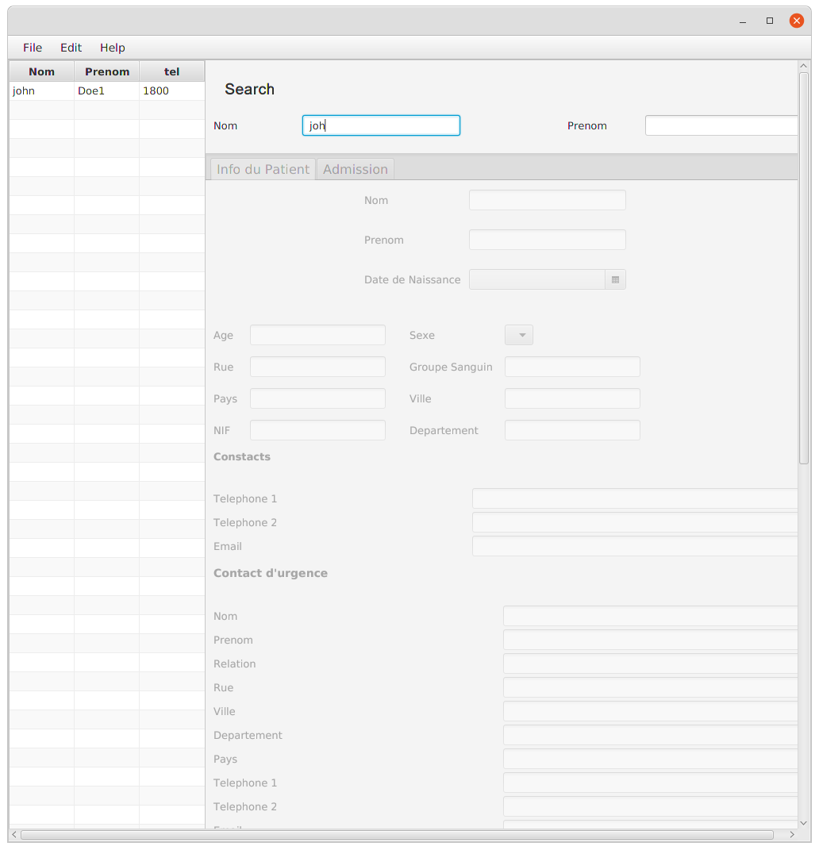

Slide 14
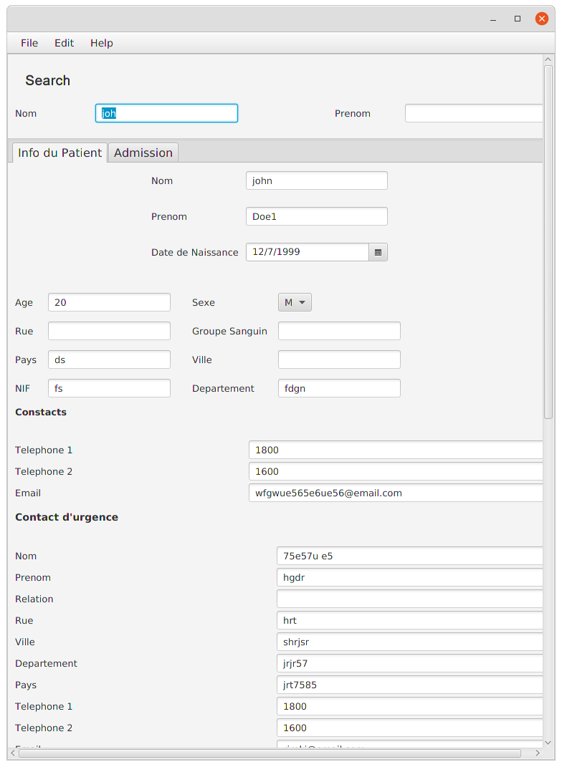
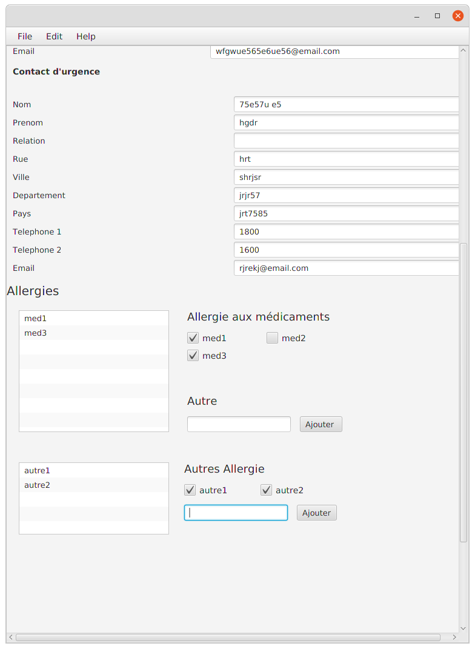

Slide 15
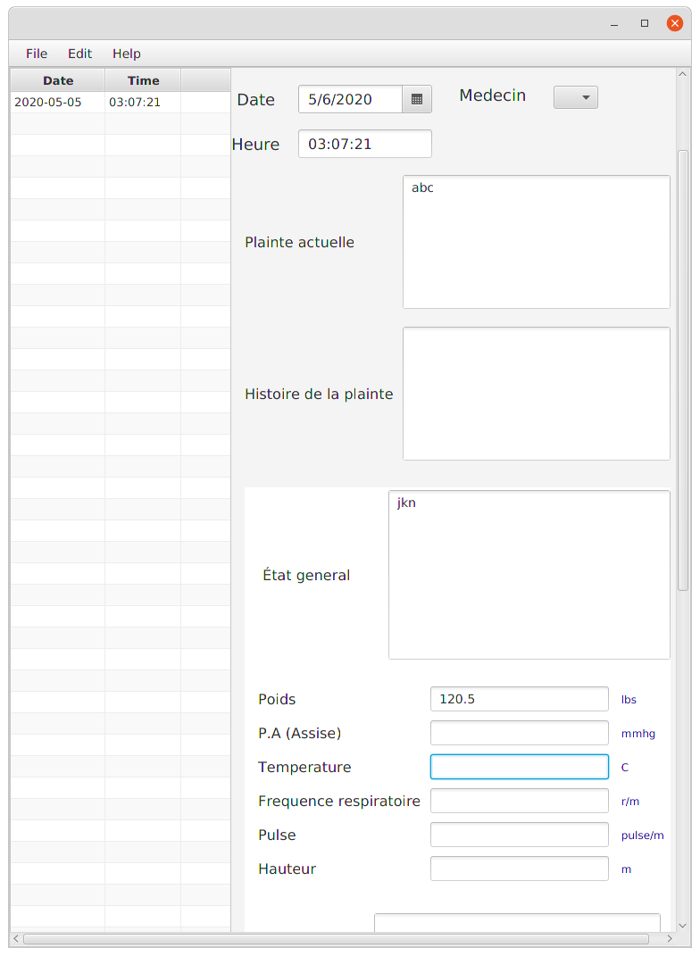

Slide 16
The End

